Slide 1


Random Forests, Climate Extreme Events and Food Production
Elisabeth Vogel, PhD student Australian German Climate & Energy College ARC Centre of Excellence on Climate System Science
25/10/2017
Image source: mechanicalforex.com/wp-content/uploads/2016/08/Selection_999256.jpg

Slide 2
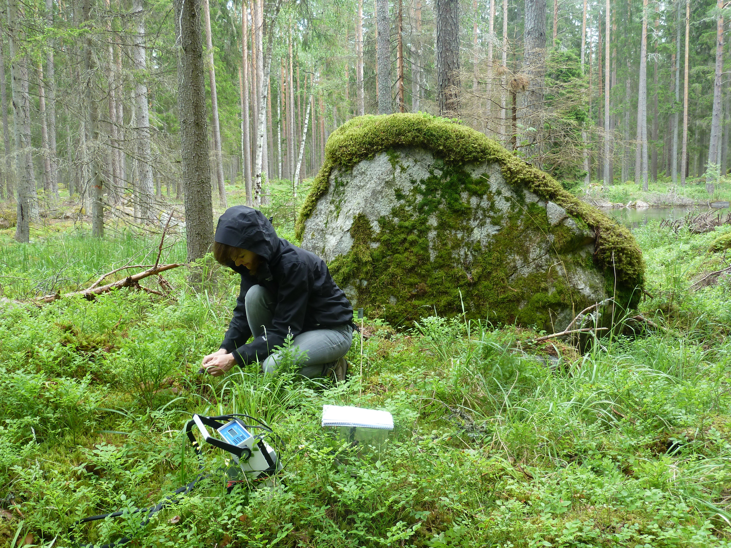
About me
MSc in Environmental Engineering, Technical University Berlin
Master thesis: The temporal and spatial variability of soil respiration in boreal forests - A case study of Norunda forest, Central Sweden
since 2014: PhD student at the Australian-German Climate & Energy College, The University of Melbourne
Research topic: The impact of climate extreme events on global agricultural yields
Research interests: Climate change impacts, extreme events, agriculture, ecosystems; Statistical and machine learning tools for data analysis and predictions
In a random forest somewhere in Sweden

Slide 3
Why do we care about climate extremes and agriculture?
Climate change increases the risks of certain types of extreme events, such as droughts and heatwaves
Agricultural sector particularly vulnerable to extreme weather events as it depends on weather conditions during the growing season
Production shocks → Price spikes that have impacts not only locally, but worldwide Example: 2007 European heatwave; 2010 Russian heatwave
Important to get a better understanding of the impact of extreme events on crop yields to adapt the global food system
Source: FAOSTAT

Slide 4
Overview
Part 1: Random Forests
What are Random Forests?
Advantages / Disadvantages
How to set up Random Forests in R
Part 2: Can we use Random Forests to analyse the impacts of climate extreme events on global agricultural yields?

Slide 5
Part 1: Random Forests

Slide 6
What is a “Random Forest”?
A machine learning algorithm based on an ensemble of decision trees → used for predictive modelling
For classification and regression problems
classification: predicting to which category a new observation belongs, e.g. medicine: high or low risk of diabetes
regression: predicting continuous values
Supervised learning method:
Takes a training dataset of predictor and predicted variables and identifies relationships in the data → these relationships are then used to predict the outcome for new observations or samples
Described in: Breiman (2001)

Slide 7
A single decision tree
Netflix suggesting movies: Will I like this movie?
Action movie?
Yes
No
NO
Dark Scandinavian crime movie?
Yes
No
YES
NO

Slide 8

Combination of decision trees
Image source: bonocle.files.wordpress.com/2012/01/tumblr_ls3tb9dqfp1qf8r8uo1_500.png
Netflix suggesting movies: Will I like this movie?
Action movie?
Drama?
Yes
No
No
Yes
NO
YES
Dark Scandinavian crime movie?
Won a film prize?
Ryan Gosling?
Yes
No
Yes
No
Yes
No
YES
NO
YES
NO
YES
NO

Slide 9
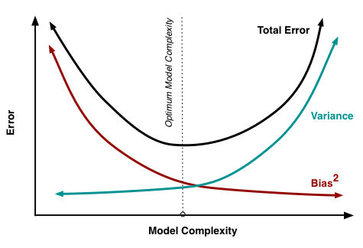
Decision trees
Biggest disadvantage is that they tend to overfit the data, especially when they are very deep
Trade-off between bias and variance:
Small trees: high bias, low variance
More complex trees: low bias, but high variance
May therefore have poor performance on new observations
Can be overcome by growing a large number of independent decision trees based on random sub-samples of the dataset → Random forest
Image source: scott.fortmann-roe.com/docs/docs/BiasVariance/biasvariance.png

Slide 10
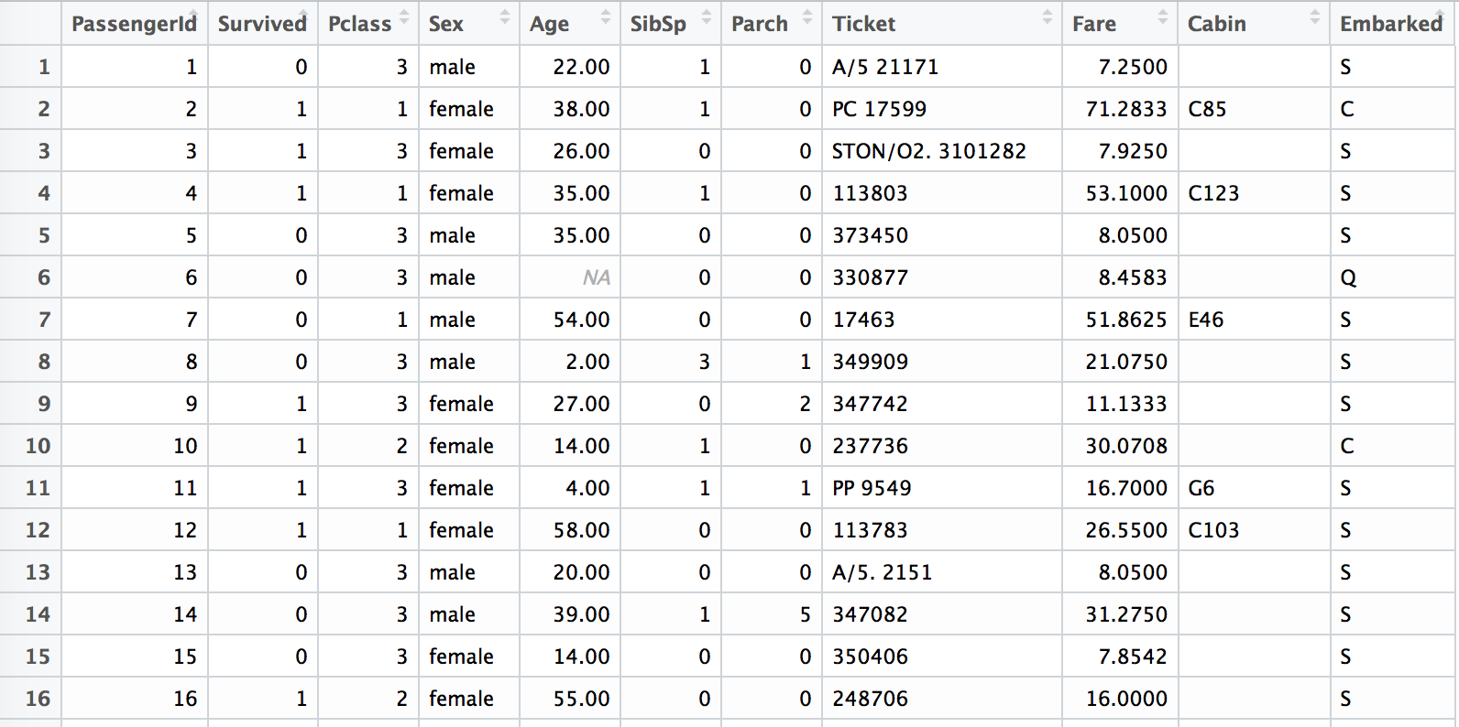
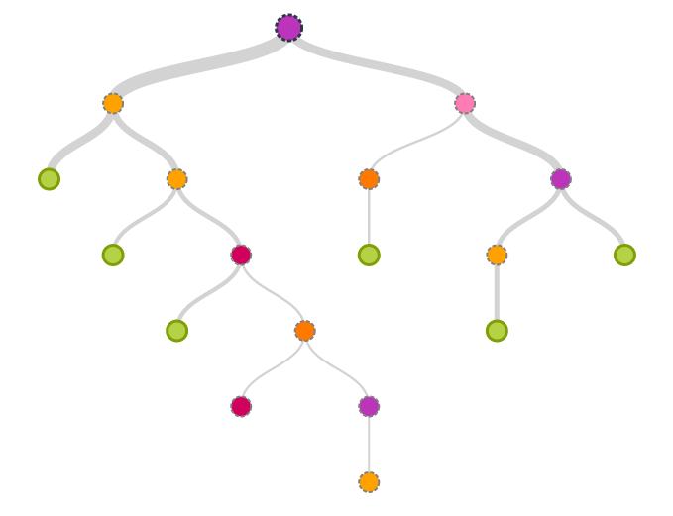
Random forests
Source: https://www.kaggle.com/c/titanic/data
Data set:
K predictor variables (independent variables, features)
1 predicted variable (dependent variable, label)
N observations (samples)
For every decision tree d:
randomly select a subset of n observations (with replacement)
create an optimal decision rules to sub-divide the data
at every decision split: only use a randomly selected subset of k predictors to choose from for decision rule
repeat iii) until specified tree depth is reached
Random forest
grow D decision trees

Slide 11
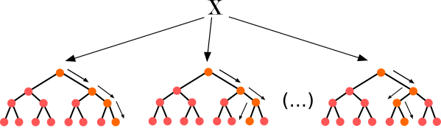
Random forests
Predictions: using majority vote (categorical variables) or mean (continuous variables)
Categorical variable
Continuous variable
red!
red!
blue!
28.1!
37.5!
11.7!
red
25.8

Slide 12
Advantages, drawbacks and applications
Advantages:
Good predictive skill
Can be used for predictions of continuous, binary and categorical variables
Almost no predictor preparation:
can use continuous or categorical variables
no linearity or normality requirements
can be used to impute missing values
Robust to collinearities in the data
Selects most important features and ignores other features
Drawbacks:
“black box”, hard to interpret (diagnostic plots can help visualise some of the patterns)
Can become large in size and slow to train compared to linear models
Examples of applications:
Land use classification from satellite images
Prediction of biological properties of molecules
Assessment of credit risks

Slide 13
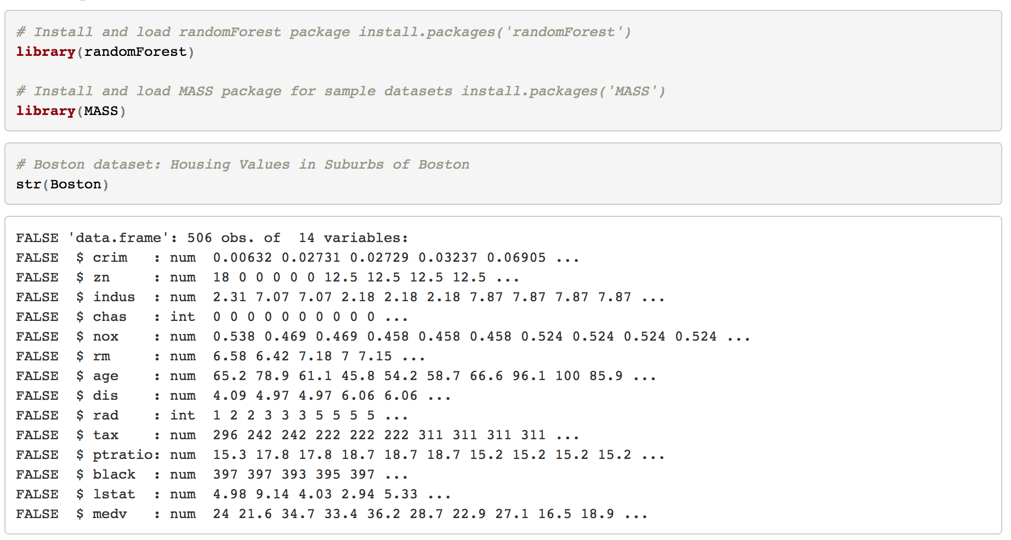
Creating Random Forests in R
based on: T. Hastie and R. Tibshirani Online Class on Statistical Learning

Slide 14
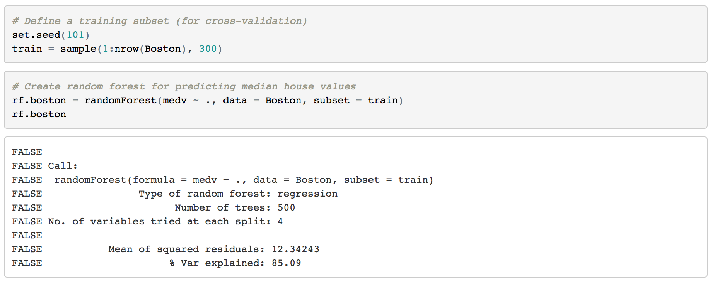
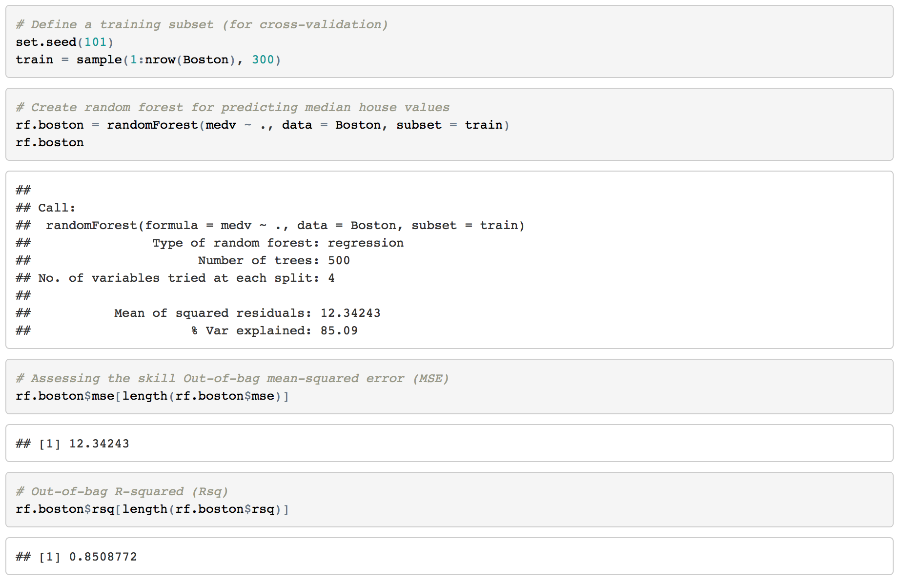
Creating Random Forests in R and skill assessment
based on: T. Hastie and R. Tibshirani Online Class on Statistical Learning

Slide 15
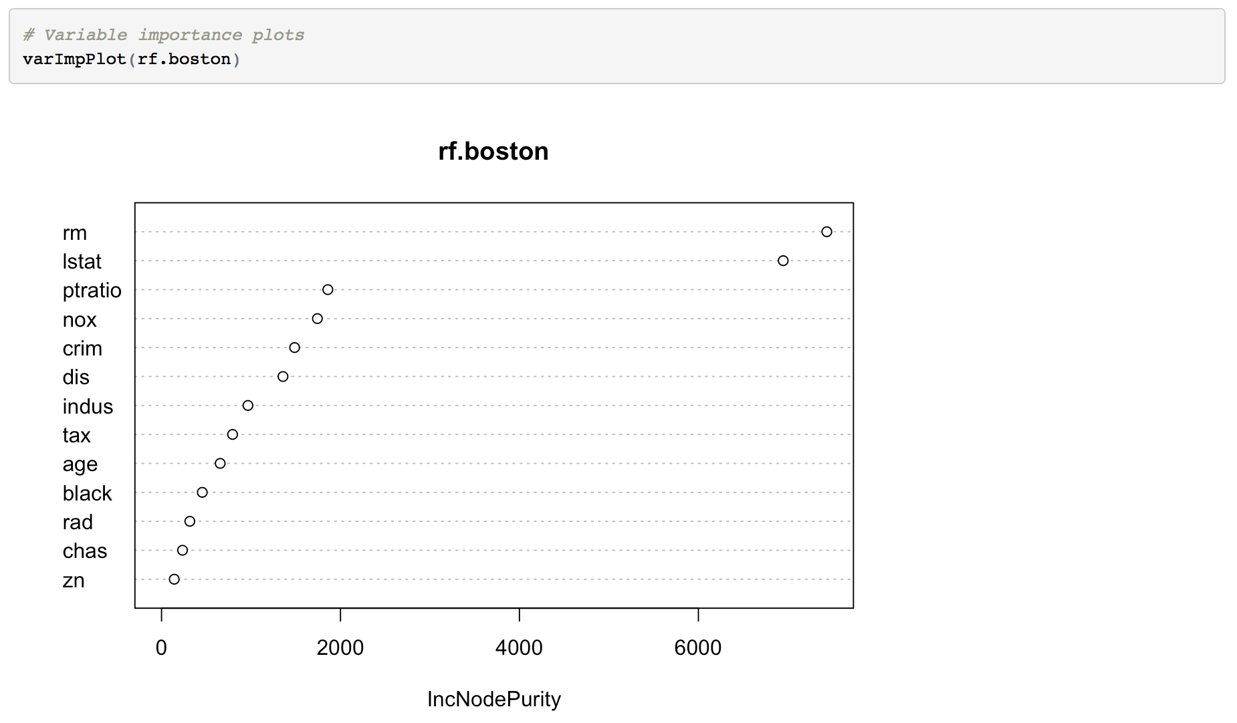
Visualisation of the model
Variable importance plots show the average reduction in performance after randomly perturbing each predictor at every decision split
Two possibilities:
increase in mean squared error (%IncMSE)
mean decrease in Gini coefficient (%IncNodePurity)
The greater the variable importance value, the more important the variable with respect to the predictive capacity of the model
Variables ranked by importance: highest to lowest
based on: T. Hastie and R. Tibshirani Online Class on Statistical Learning

Slide 16
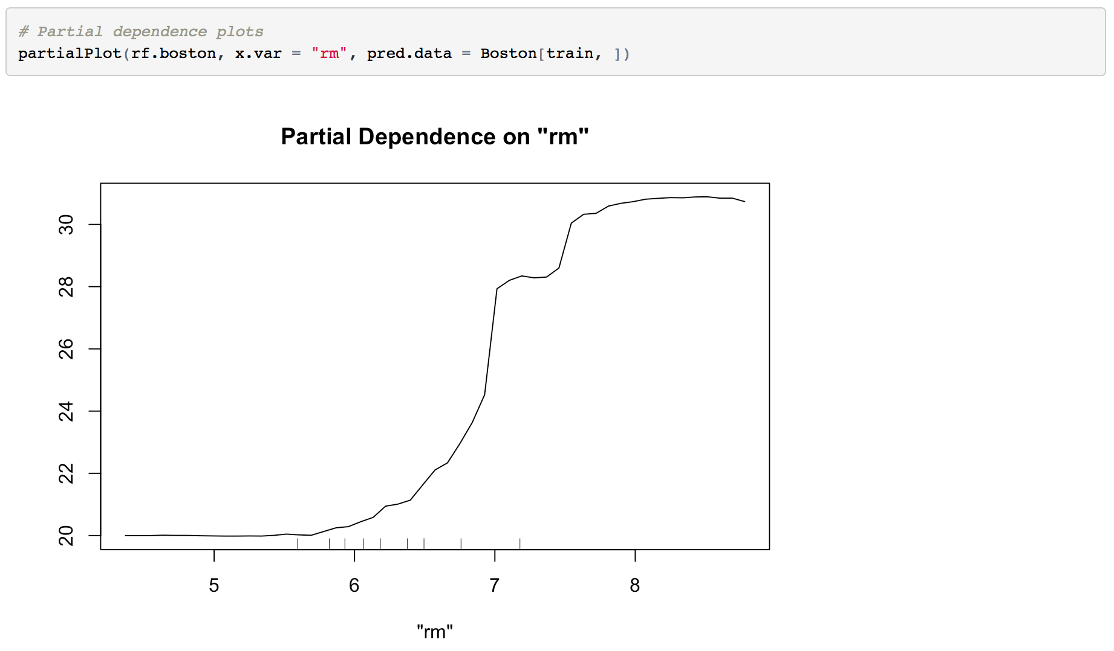
Visualisation of the model
Partial dependence plots:
Show the marginal effect (positive or negative) of a predictor variable
How does the predictor influence the outcome, if all other variables are accounted for?
based on: T. Hastie and R. Tibshirani Online Class on Statistical Learning

Slide 17
Part 2: Impacts of Climate Extreme Events on Global Agricultural Yields

Slide 18
Research approach
Main challenges:
Research approach:
Data availability at appropriate spatial and temporal scale
Length of available time series
Use a global gridded crop yield data base 47 years of yield data for wheat, maize, rice
combined with global gridded dataset on extreme event indicators (HADEX2) and global, gridded historical climate observation data (CRU TS 3.23)
Collinearity between predictor variables
Complex interactions between climate variables and yield variable
Non-linear effects
Application of random forest algorithm that is robust to collinearities between predictor variables and that can capture complex interactions between climate variables and agricultural productivity

Slide 19
Research approach
Main challenges:
Data availability at appropriate spatial and temporal scale
Length of available time series
Collinearity between predictor variables
Complex interactions between climate variables and yield variable
Non-linear effects
Fig.: Total wheat production per grid cell (1990 – 2008) calculated from Ray et al. gridded production data set.

Slide 20
Methodology – Data preparation
Historical climate data (monthly data)
Crop calendar: Planting and harvesting months
Calculation of growing season climate from climate data based on crop calendar for each crop type and grid cell
Cross-validation:
5 iterations: 80% training years, 20% test years
Prediction of yield anomalies for test years → combined after 5 iterations to one time series (out-of-sample predictions)
Calculation of skill metrics for OOS-predictions (R2, RMSE)
Regridding to common grid: 1.5° x 1.5°
Detrending of time series: SSA detrending
Standardisation of time series (division by standard deviation)
Random Forest: prediction of annual crop yield anomalies for each crop type and grid cell

Slide 21
Methodology – Predictors
Mean climate during the growing season:
mean temperature
mean precipitation
mean daily temperature range
Extreme event indicators
maximum temperature
minimum temperature
frequency of unusually warm days (> 90th percentile)
frequency of unusually cold nights (< 10th percentile)
frost day frequency
maximum 5-day precipitation intensity
drought indicator: Standardised Precipitation Index (SPI-6)

Slide 22
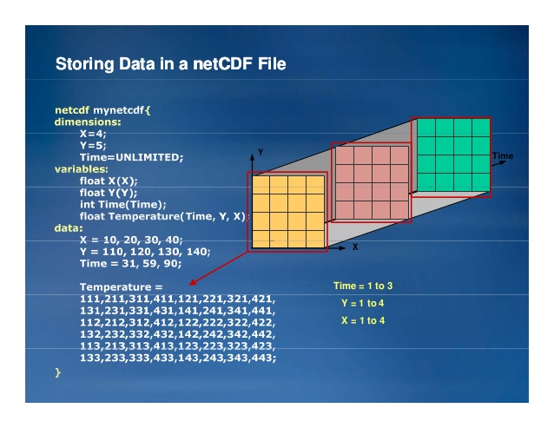
NetCDF file format
“Network Common Data Form”
Standard file format in the atmospheric, ocean and climate sciences for storing gridded data, e.g.
climate model output
meteorological observations
set of software libraries that can create, read and write netCDF files
stores metadata inside the file (e.g. variable names, units)
portable file format
can be a steep learning curve and sometimes errors related to different netcdf versions / naming conventions etc.
R libraries to work with netcdf files: RNetCDF, ncdf4 and others
Image source: www.slideshare.net/HDFEOS/working-with-hdf-and-netcdf-data-in-arcgis-tools-and-case-studies

Slide 23
How much of the global and continental yield variability is explained by the random forest model?
R2 value of correlation between actual and predicted yield anomalies, aggregated over continents and globally
Our statistical model is able to explain about 50% of variability of detrended global maize and spring wheat yields
Soybeans and rice: 20-25% of variance of anomalies explained
Wheat fluctuations captured best in Australia: approx. 70%

Slide 24
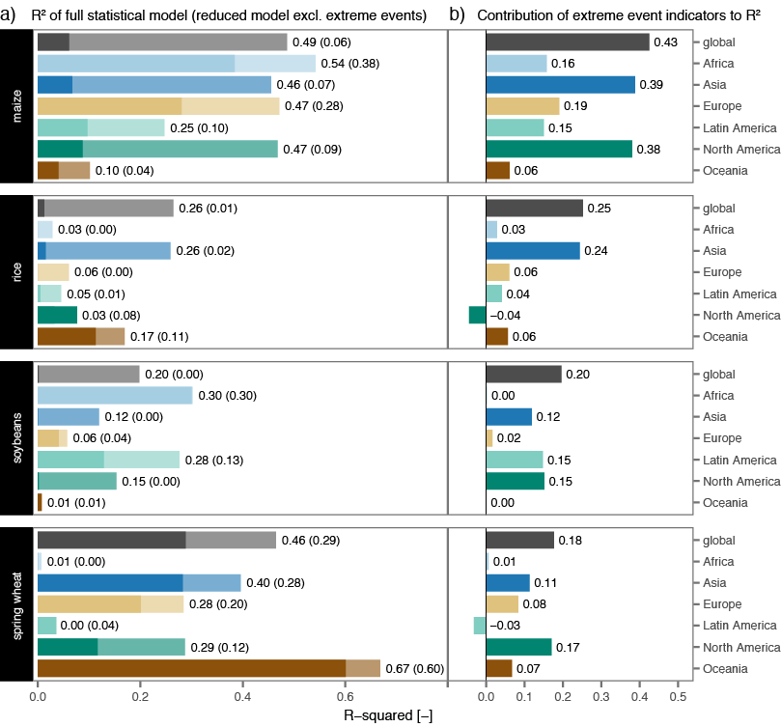
What is the fraction of variability explained by extreme indicators?
R2 value of correlation between actual and predicted yield anomalies, aggregated over continents and globally
Two predictor sets:
full model: using all predictor variables, including mean climate and extreme indicators
reduced model: only precipitation and temperature
Extreme event indicators increase explained variability considerably at the global scale as well as for certain regions
Globally, increases of R²:
Maize: 43%
Rice: 25%
Soybeans: 20%
Spring wheat: 18%

Slide 25
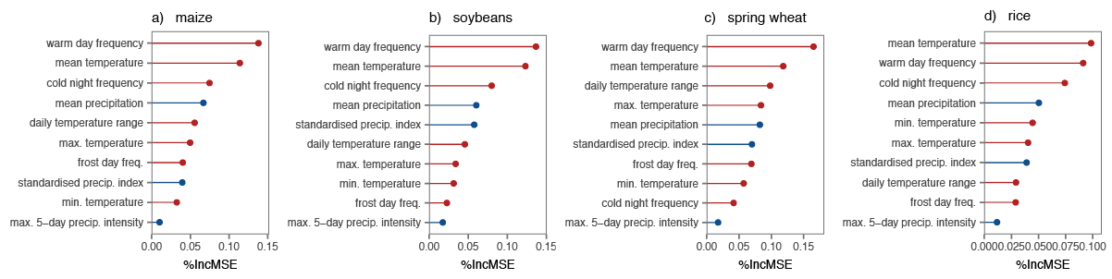
Which predictors have the greatest influence on crop yields? - Variable importance ranking
Variable importance plots for all area harvested, globally
Blue: Rainfall-related predictors
Red: Temperature-related predictors
Temperature-related indices are most important predictors for all crops
Precipitation has comparatively low importance metrics
Lowest: 5-day rainfall intensity (heavy precipitation index)

Slide 26
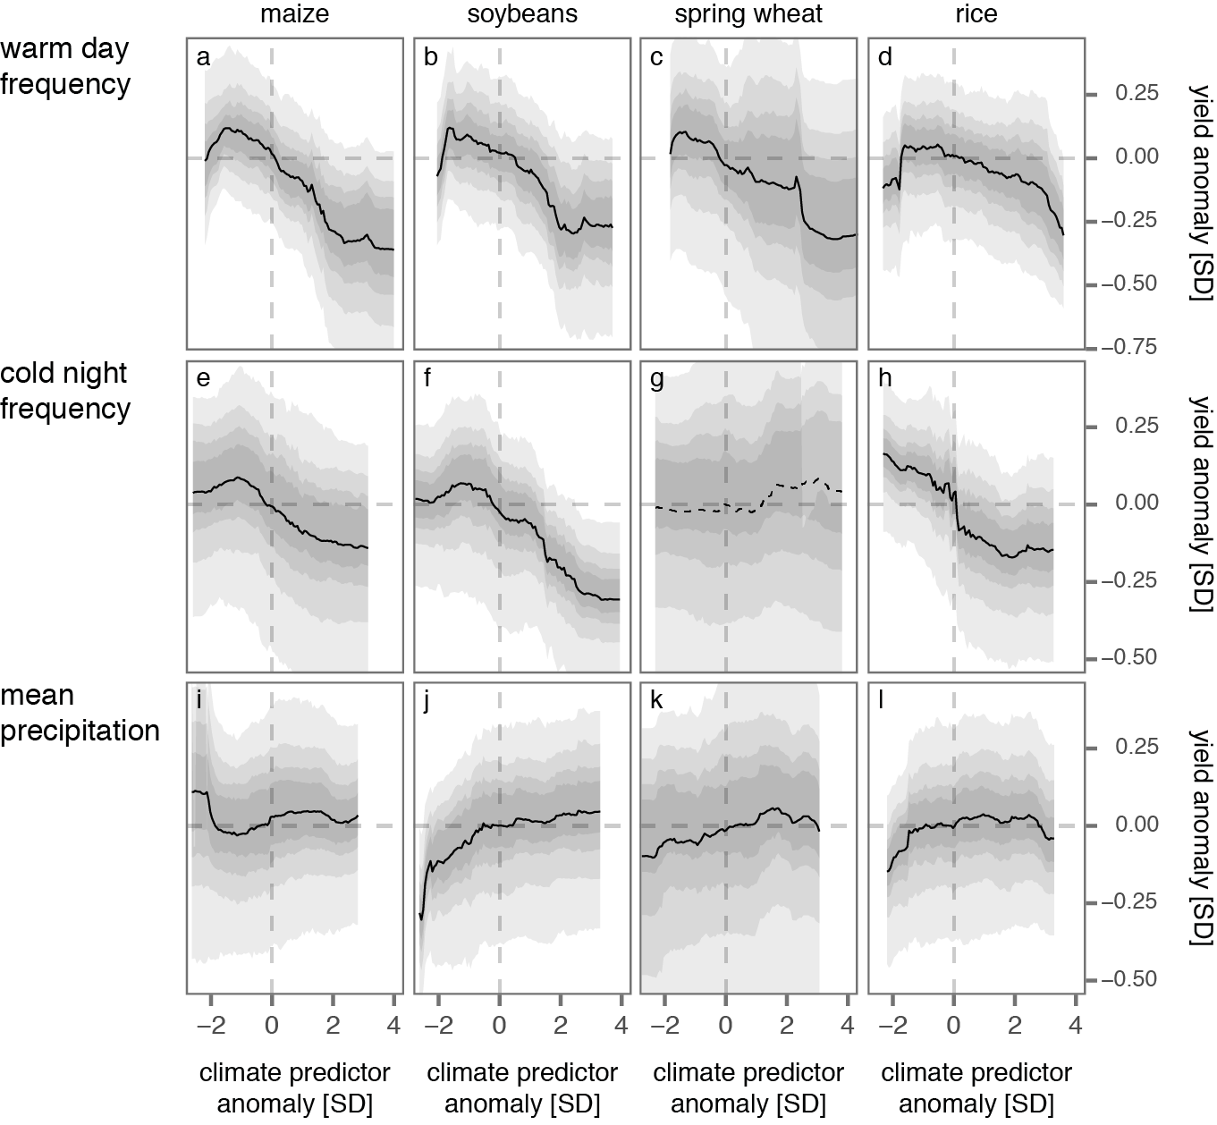
The marginal effect of predictors: partial dependence plots
Clearly negative effect of increases in extreme warm days
Positive effect of decreases in cold nights
Association with precipitation less clear

Slide 27
Summary - some lessons I learned
Be aware of auto-correlation / data leakage: for example, if datasets have different underlying spatial resolutions, the random forest will use the coarser dataset to predict neighboring grid cells due to spatial auto-correlation / data leakage
Skill metrics: default skill metrics of random forest package: out-of-bag (OOB) error and R2 → usually very high values, better to subset the dataset manually and calculate own metrics
Partial dependence plots: include uncertainty bands to avoid over-interpretation of the functional relationships

Slide 28
Summary – Random forests
Random forests are a machine learning technique used for classification and prediction
High accuracy and efficiency on large datasets
Only little data preparation needed, can be used on different data types and to fill missing values
“Black-box”, but visualisation tools allow to better understand the relative influence of each predictor

Slide 29

Thank you! And Happy Birthday, R-Ladies! :) Contact: elisabeth.vogel@climate-energy-college.org

Slide 30
References and additional resources
Tutorial on Statistical Learning (including Random Forests): https://www.r-bloggers.com/in-depth-introduction-to-machine-learning-in-15-hours-of-expert-videos/
Introduction to Random Forests by Breiman and Cutler: https://www.stat.berkeley.edu/~breiman/RandomForests/cc_home.htm
Breiman (2001): http://oz.berkeley.edu/~breiman/randomforest2001.pdf
Kaggle – “Learning Machine Learning from Disaster”: https://www.kaggle.com/c/titanic
NetCDF: http://geog.uoregon.edu/bartlein/courses/geog490/week04-netCDF.html

